Slide 1
IMS Aries軟體介紹
簡報者: David

Slide 2
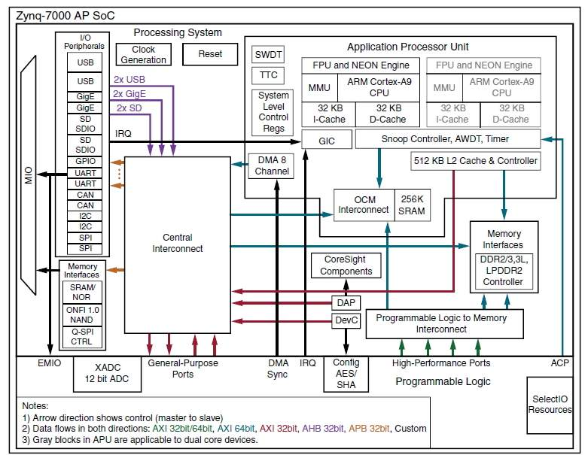
Aries Core IP

Slide 3
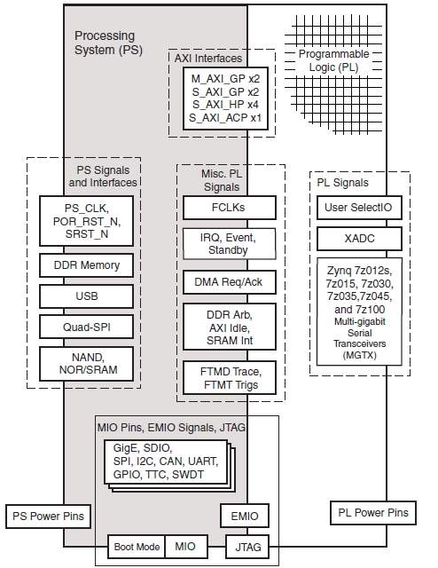
Signals, Interfaces, and Pins

Slide 4
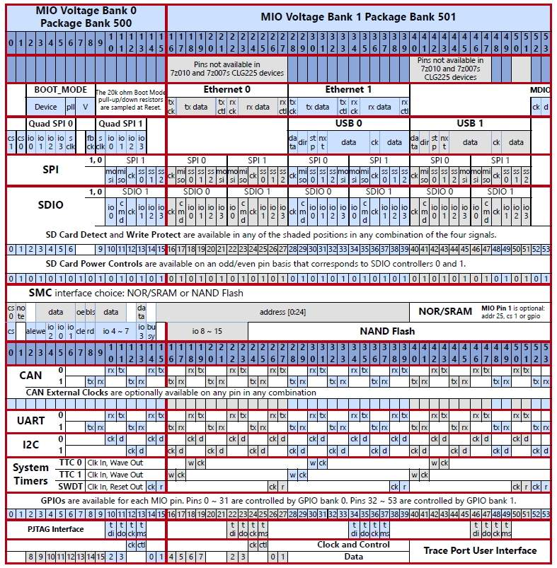
Multiplexed I/O(MIO)

Slide 5
Video Output Setting
int periphs_bring_up_output_pipeline()
{
// Look up timing info from ID
vres_get_timing(0, &vres_timing0);
vres_get_timing(new_output_timing, &vres_timing1);
// Software Reset Output Pipeline
vtiming_gen_reset(p_periphs_inst->p_vtg_inst_0);
vtiming_gen_reset(p_periphs_inst->p_vtg_inst_1);
//VDMA Read
vdma_reset(p_periphs_inst->p_vdma_camera_inst , XAXIVDMA_READ);
vdma_reset(p_periphs_inst->p_vdma_camera_freeze_inst , XAXIVDMA_READ);
// Set output frame size for Video Output interface
vid_io_intf_update_output_fsize(p_periphs_inst->p_vid_io_GUI_inst, new_output_timing);
// Set VTG_0 output timing
vtiming_gen_config(p_periphs_inst->p_vtg_inst_0, new_output_timing, 2);
//vtiming_gen_config(p_periphs_inst->p_vtg_inst_0, 0, 2); // VGA, for test
// Set VTG_1 output timing
vtiming_gen_config(p_periphs_inst->p_vtg_inst_1, new_output_timing, 2);
}

Slide 6
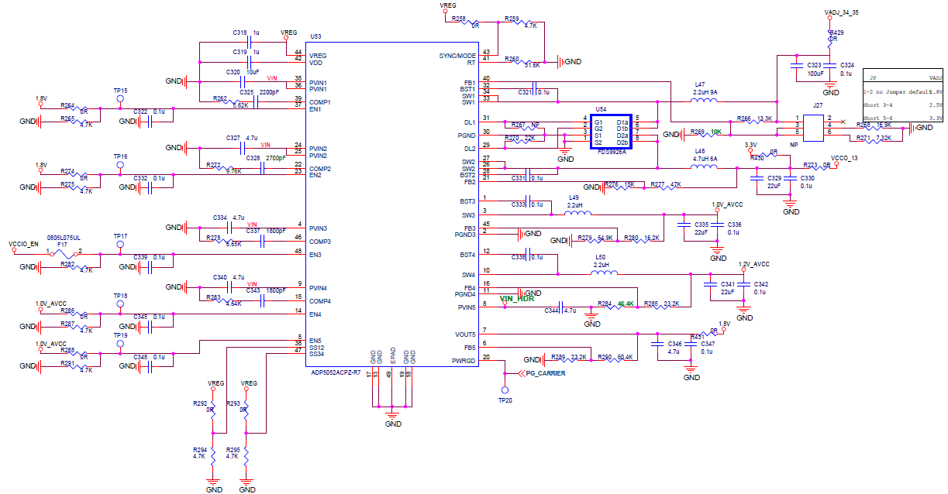
Power Block

Slide 7
xxxx

Slide 8
綠色：好的frame， 紅色：壞的frame
2秒
2秒
OSD顯示
信號不良
判斷條件:
兩秒內掉了>10個frame
信號恢復正常後持續顯示警告2秒
OSD顯示條件
中斷
狀態顯示

Slide 9
31
30
29
28
27
26
25
24
23
22
21
20
19
IO2
IO1_key
IO0_CD
SW_BRIGHT
SW_DARKEN
SW_METER
SW_START
SW_SMART
CAM_LED
FAN_EN
LED_RED
LED_5
LED_4
LED_3
LED_2
LED_1
LED_AUTO
LED_AVG
LED_CEN
31
30
29
28
27
26
25
24
23
22
21
20
19
18
17
16
15
14
13
12
11
10
9
8
7
6
5
4
3
2
1
0

Slide 10
31
0
31
DATA_2_RO
E000_A068
30
0
30
29
0
29
28
0
28
27
0
27
26
0
26
25
0
25
24
0
24
23
0
23
22
0
22
21
0
21
20
0
20
19
0
19
18
IO2
18
17
IO1_KEY
17
16
IO0_CD
16
15
SW_BRIGHT
15
14
SW_DARKEN
14
13
SW_METER
13
12
SW_START
12
11
SW_SMART
11
10
CAM_LED
10
9
FAN_EN
9
8
LED_RED
8
7
LED_5
7
6
LED_4
6
5
LED_3
5
4
LED_2
4
3
LED_1
3
2
LED_AUTO
2
1
LED_AVG
1
0
LED_CEN
0

Slide 11
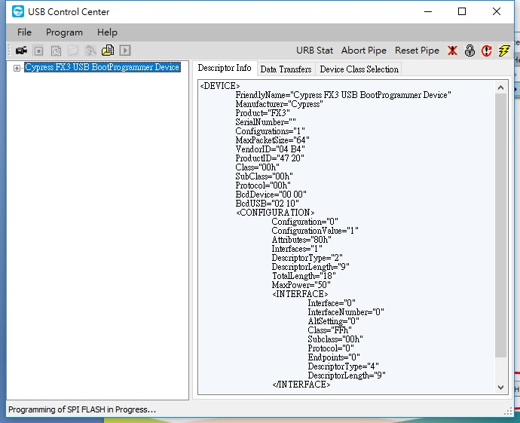
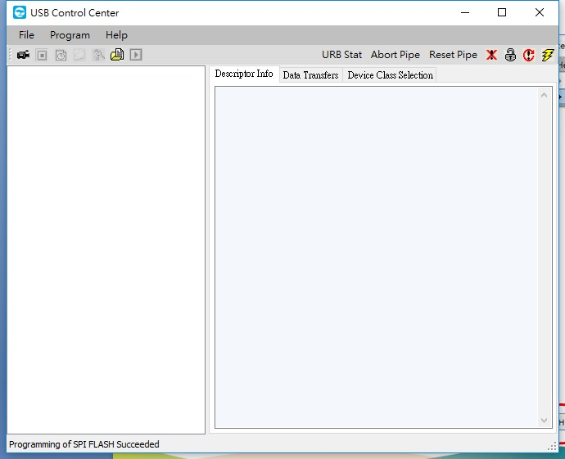
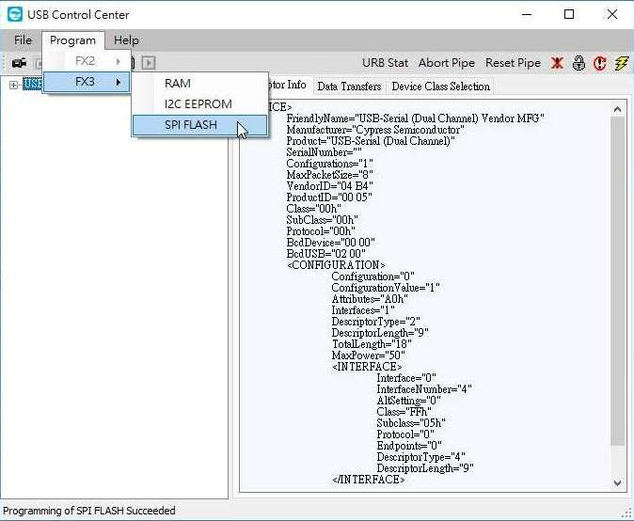
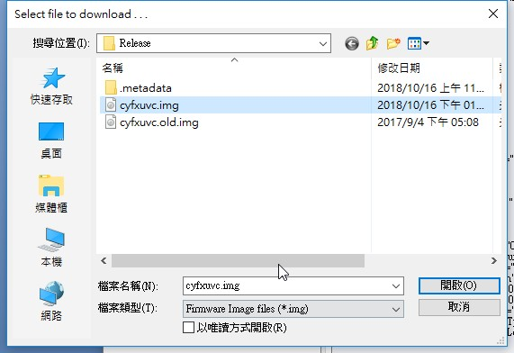
Cypress FF3 燒錄
開啟Cypress/Control Center
Program/FX3/SPI FLASH
選取燒錄檔案(xxx.img)即行燒錄

Slide 12
Cypress FF3 使用
建立專案
開啟Cypress/EZ USB Suite
File/Import
General/File System
Project/Clean
Project/Build All，產出燒錄檔案(xxx.img)

Slide 13
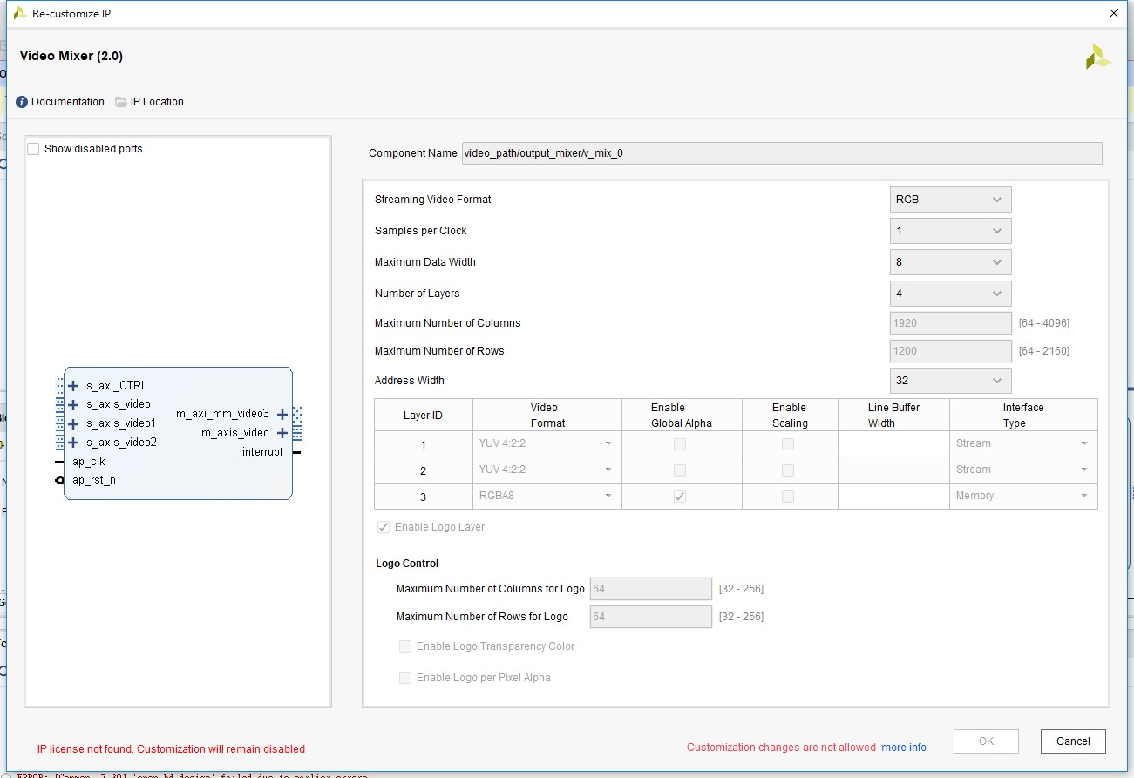
Vivado看Layer
IP INTEGRATOR/Open Block Design
點開video path
展開output_mixer
點開v_mix_0

Slide 14

設定圖層
framebuffer0
(688, 16)
framebuffer1
L0
L1
1920 X 1080
1216 X 912
START
(16,584)
760 X 384
L2
640 X 480
L3

Slide 15
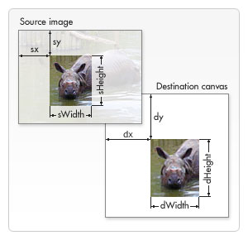
gdispImage *p_Image;
p_Image = &myImage;
gdispImageOpenFile(p_Image, step_3);
W H sx sy dx dy
pixmap_draw(pixmap_1, surface_1, LAYER1_WIDTH, LAYER1_HEIGHT, p_Image, 100, 200, 300, 400, alpha, POSITION_MIDDLE_LEFT);
1920 W 16 16
gdispBlitArea(LAYER0_WIDTH - LAYER1_WIDTH - BORDER_X, BORDER_Y,
W H
LAYER1_WIDTH, LAYER1_HEIGHT, surface_1);
gdispImageClose(p_Image);
pixmap_draw(pixmap, surface, W, H, p_Image, sx, sy, dx, dy, alpha, position)
{
sWidth = p_Image->width;
sHeight = p_Image->height;
status = gdispGImageDraw(pixmap, p_Image, dx, dy, sWidth, sHeight, sx, sy);
不透明貼圖
sx = 0; sy = 0;
sWidth = p_Image->width;
sHeight = p_Image->height;
dx = 200; dy = 100;
status = gdispImageDraw(p_Image, dx, dy, sWidth, sHeight, sx, sy);
w
h
H
W

Slide 16
設定貼圖
gdispImage *p_Image;
p_Image = &myImage;
gdispImageOpenFile(p_Image, step_3);
W H sx sy dx dy
pixmap_draw(pixmap_1, surface_1, LAYER1_WIDTH, LAYER1_HEIGHT, p_Image, 100, 200, 300, 400, alpha, POSITION_MIDDLE_LEFT);
1920 W 16 16
gdispBlitArea(LAYER0_WIDTH - LAYER1_WIDTH - BORDER_X, BORDER_Y,
W H
LAYER1_WIDTH, LAYER1_HEIGHT, surface_1);
gdispImageClose(p_Image);
pixmap_draw(pixmap, surface, W, H, p_Image, sx, sy, dx, dy, alpha, position)
{
sWidth = p_Image->width;
sHeight = p_Image->height;
status = gdispGImageDraw(pixmap, p_Image, dx, dy, sWidth, sHeight, sx, sy);
不透明貼圖
sx = 0; sy = 0;
sWidth = p_Image->width;
sHeight = p_Image->height;
dx = 200; dy = 100;
status = gdispImageDraw(p_Image, dx, dy, sWidth, sHeight, sx, sy);
w
h
H
W

Slide 17
設定圖層
製作右大圖(L1)
pixmap_1 = gdispPixmapCreate(LAYER1_WIDTH, LAYER1_HEIGHT);
// 開啟 1216 X 912
surface_1 = gdispPixmapGetBits(pixmap_1);
pixmap_draw(pixmap_1, surface_1, LAYER1_WIDTH, LAYER1_HEIGHT, NULL,
0, 0, 0, 0, 0, POSITION_MIDDLE_CENTER);
把右大圖(L1)加到底圖(L0)之上
// Blit surface_1 to the real display at the new position
L1之左上角x L1之左上角y, L1之W, L1之H
gdispBlitArea(LAYER1_START_X, LAYER1_START_Y, LAYER1_WIDTH, LAYER1_HEIGHT, surface_1);
void RunMixer(XV_Mix_l2 *mix)
{
layer1.StartX = LAYER1_START_X;
layer1.StartY = LAYER1_START_Y;
XVMix_LayerEnable(periphs_inst.p_vid_output_mixer_l2_inst, XVMIX_LAYER_1);

Slide 18
draw
開啟一圖
gdispImage *p_Image;
p_Image = &myImage;
status = gdispImageOpenFile(p_Image, step_3); //開檔並讀資料到p_Image裏
gdispImageClose(p_Image);
畫不透明圖, 可畫多張
status = gdispImageDraw(p_Image, dx, dy, sWidth, sHeight, sx, sy);
用來畫透明圖, 只能畫一張
pixmap_draw(pixmap_1, surface_1, LAYER1_WIDTH, LAYER1_HEIGHT, p_Image, 0, 0, 0, 0, alpha, POSITION_MIDDLE_CENTER);
gdispBlitArea(LAYER0_WIDTH-LAYER1_WIDTH-BORDER_X, BORDER_Y, LAYER1_WIDTH, LAYER1_HEIGHT, surface_1);
清除圖片, 只能全部清除
pixmap_draw(pixmap_1, surface_1, LAYER1_WIDTH, LAYER1_HEIGHT, NULL, 0, 0, 0, 0, 0, POSITION_MIDDLE_CENTER);
gdispBlitArea(LAYER0_WIDTH-LAYER1_WIDTH-BORDER_X, BORDER_Y, LAYER1_WIDTH, LAYER1_HEIGHT, surface_1);

Slide 19
draw
漸層色
W H
pixmap_draw_gradient(pixmap_1, surface_1, LAYER1_WIDTH, LAYER1_HEIGHT,
dx dy dW dH c_st c_sp alpha
200, 200, 256*3, 100, Lime, Blue, 0xff);
gdispBlitArea(LAYER0_WIDTH-LAYER1_WIDTH-BORDER_X, BORDER_Y, LAYER1_WIDTH, LAYER1_HEIGHT, surface_1);
在LAYER1上畫漸層色，起點(dx,dy)，畫dW X dH，顏色由c_st到c_sp，分256階
(dx, dy) dW
c_st c_sp
dH

Slide 20
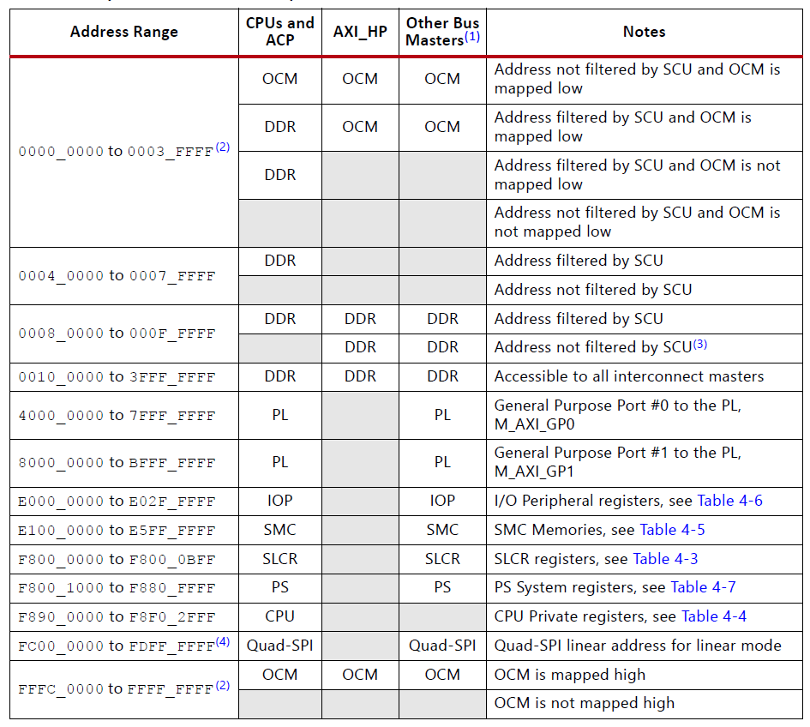
Address Map

Slide 21
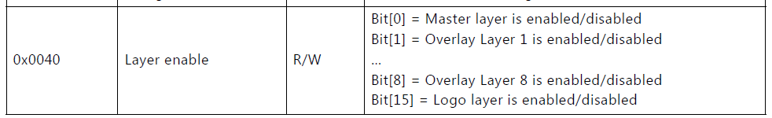
Mixer Layer Enable
Xilinx_VideoMixer_v3.0_PG243.pdf
Mixer 43CC_0000 ~ 43CF0000
Offset 0x0040
L0 => bit0 //background
L1 => bit1 //right
L2 => bit2 //left
L3 => bit3 //OSD
1: enable, 2: disable

Slide 22
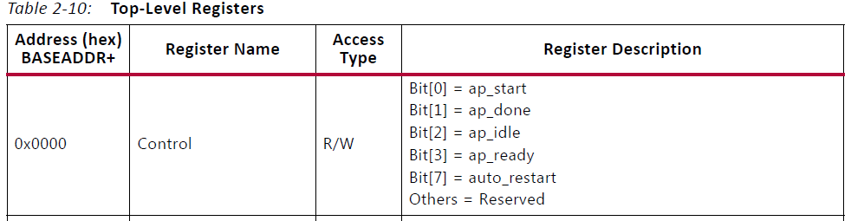
Mixer Control
0x43CC_0000
Auto start
bit7 auto_restart
Register直接寫0x80
start
void XV_mix_Start(XV_mix *InstancePtr)
{
u32 Data; //Bit7 保留 bit0填1
Data = XV_mix_ReadReg(InstancePtr->Config.BaseAddress, XV_MIX_CTRL_ADDR_AP_CTRL) & 0x80;
XV_mix_WriteReg(InstancePtr->Config.BaseAddress, XV_MIX_CTRL_ADDR_AP_CTRL, Data | 0x01);
}
//BaseAddr = 0x43CC0000 offset= 0x00000000 data = 0x00000081

Slide 23
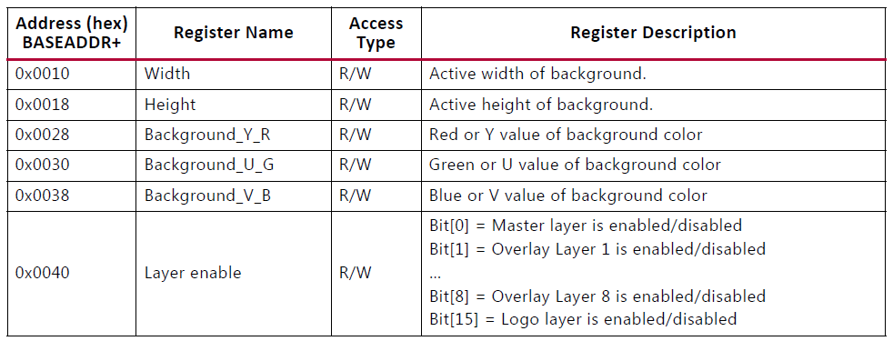
Mixer
0x0010 XV_mix_Set_HwReg_width Layer width
0x0018 XV_mix_Set_HwReg_height Layer height
0x0028 XV_mix_Set_HwReg_background_Y_R R
0x0030 XV_mix_Set_HwReg_background_U_G G
0x0038 XV_mix_Set_HwReg_background_U_B B
0x0040 XV_mix_Set_HwReg_layerEnable Enable

Slide 24
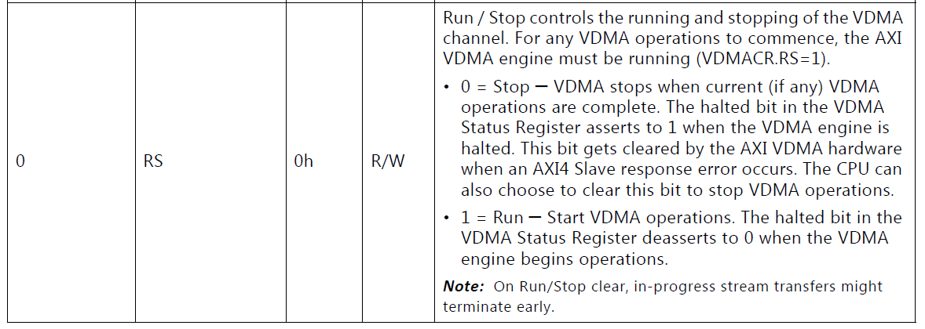
VDMA start
Xilinx_VDMA_v6.2_PG020.pdf
DMA啟動
WRITE(S2MM) READ(MM2S)
Camera VDMA start hw 0x4300_0030填bit0 0x4300_0000填bit0
start tf 0x4300_00A0填v 0x4300_0050填v
Camera freeze VDMA start hw 0x4303_0030填bit0 0x4303_0000填bit0
start tf 0x4303_00A0填v 0x4303_0050填v

Slide 25
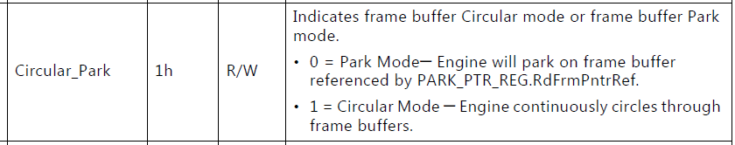
VDMA freeze
Xilinx_VDMA_v6.2_PG020.pdf
Camera VDMA 4300_0000 ~ 4300_0000 左小圖
Camera Freeze VDMA 4303_0000 ~ 4303_0000 右大圖
Freeze
MM2S_VDMACR(0x00) bit 1
0: Freeze(Park mode)
1: Circular Mode(Normal mode)
左小圖(0x43000000) 右大圖(0x43030000)

Slide 26
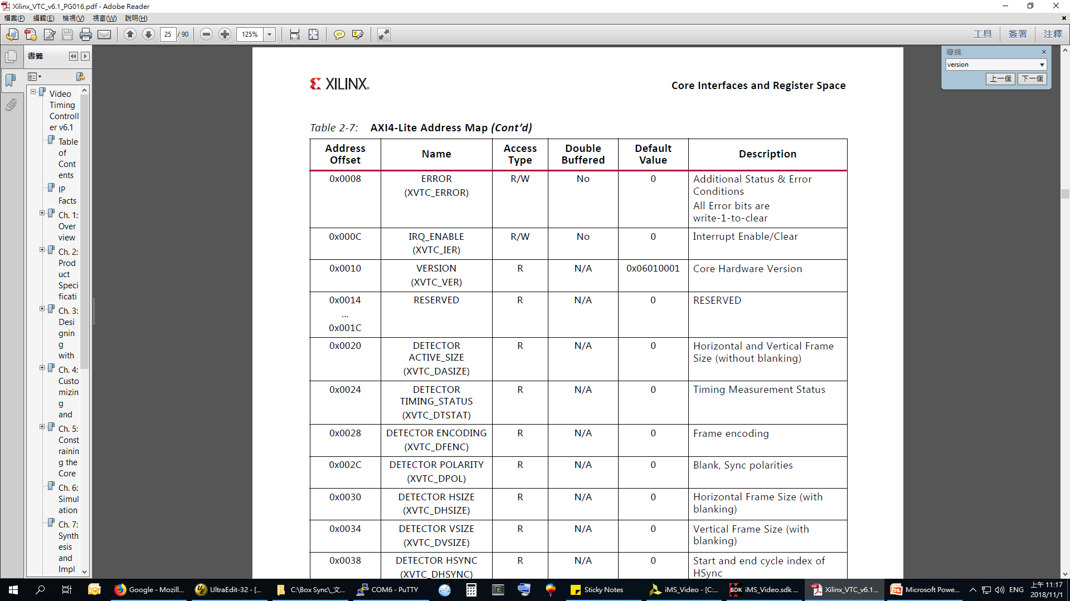
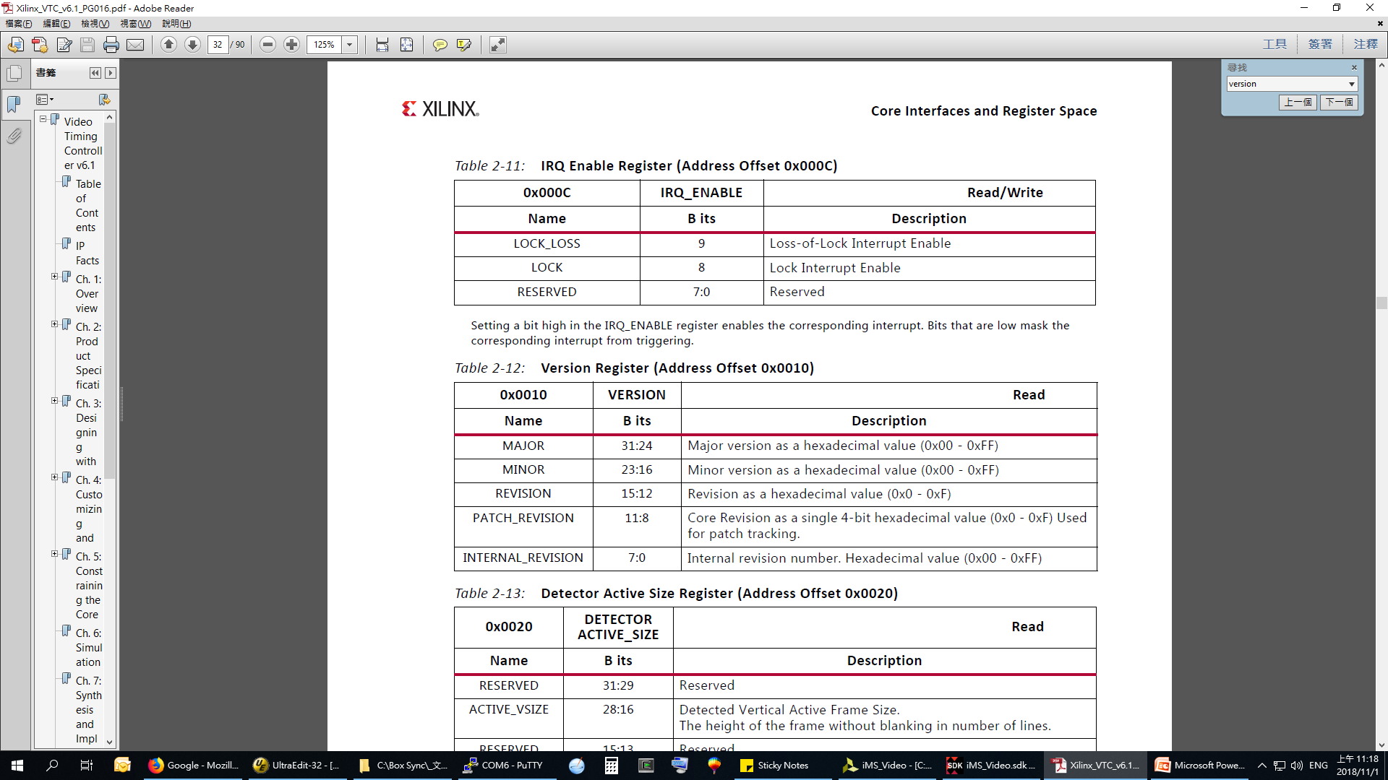
VTC version
Xilinx_VTC_v6.1_PG016.pdf
xvtc.c: u32 XVtc_GetVersion(XVtc *InstancePtr)
{
u32 Version;
/* Read Version register */ 0x10
Version = XVtc_ReadReg(InstancePtr->Config.BaseAddress, XVTC_VER_OFFSET);
return Version;
}
Result : 0x0601000B 0000_0110_0000_0001 0000_0000_0000_1011
Major = 6 Minor = 1 Rev = 0

Slide 27
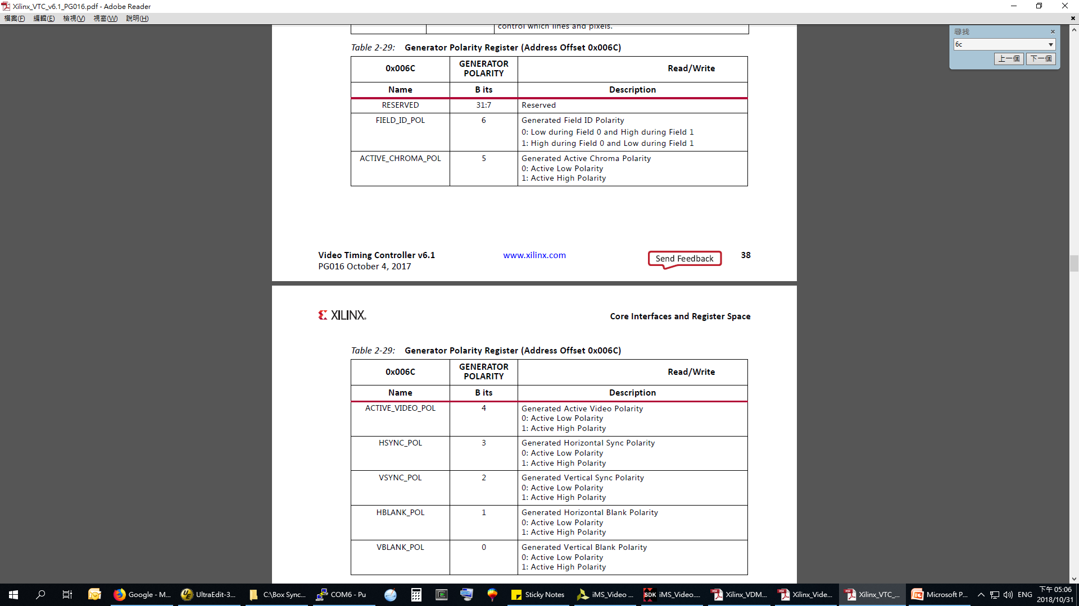
Video Timing Controller (VTC)
Xilinx_VTC_v6.1_PG016.pdf
Setup polarity
xvtc.c:XVtc_SetPolarity
BaseAddr = 0x43C90000
offset= 0x0000006C
data = 0x0000003F

Slide 28
UART1讀一拜出來
Xilinx_Zynq-700_TRM_UG585.pdf
char c[1] = {0};
c[0] = XUartPs_RecvByte(XPAR_PS7_UART_1_BASEADDR); //0xE000_1000
xuartps_hw.c
u8 XUartPs_RecvByte(u32 BaseAddress)
{
u32 RecievedByte;
if (!XUartPs_IsReceiveData(BaseAddress))
return 0;
RecievedByte = XUartPs_ReadReg(BaseAddress, XUARTPS_FIFO_OFFSET);
return (u8)RecievedByte;
}
#define XUartPs_IsReceiveData(BaseAddress) \
!((Xil_In32((BaseAddress) + XUARTPS_SR_OFFSET) & \
(u32)XUARTPS_SR_RXEMPTY) == (u32)XUARTPS_SR_RXEMPTY)
#define XUARTPS_SR_OFFSET 0x002CU /**< Channel Status [14:0] */
#define XUARTPS_FIFO_OFFSET 0x0030U /**< FIFO [7:0] */

Slide 29
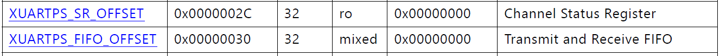

Slide 30
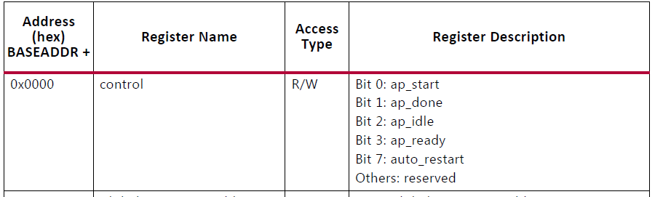
TPG setup start
Xilinx_VTPG_PG103.pdf 0x43D4_0000
Auto restart bit7 Register直接寫0x80
XV_tpg_EnableAutoRestart(p_periphs_inst->p_tpg_GUI_inst);
void XV_tpg_EnableAutoRestart(XV_tpg *InstancePtr) {
XV_tpg_WriteReg(InstancePtr->Config.BaseAddress, XV_TPG_CTRL_ADDR_AP_CTRL, 0x80);
}//BaseAddr = 0x43D40000 offset= 0x00000000 data = 0x00000080
XV_tpg_Start(p_periphs_inst->p_tpg_GUI_inst);
void XV_tpg_Start(XV_tpg *InstancePtr) {
u32 Data; //Bit7 保留 bit0填1
Data = XV_tpg_ReadReg(InstancePtr->Config.BaseAddress, XV_TPG_CTRL_ADDR_AP_CTRL) & 0x80;
XV_tpg_WriteReg(InstancePtr->Config.BaseAddress, XV_TPG_CTRL_ADDR_AP_CTRL, Data | 0x01);
}//BaseAddr = 0x43D40000 offset= 0x00000000 data = 0x00000081

Slide 31
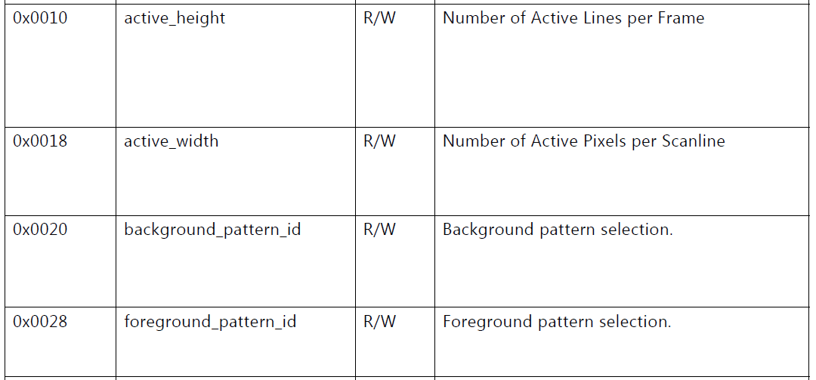
TPG setup test pattern
Xilinx_VTPG_PG103.pdf
設定test pattern
BaseAddr = 0x43D4_0000
offset= 0x00000020
data = 0~19 //BACKGROUND_PATTERN_ID

Slide 33
更新圖檔要重編ugfx
更新圖檔要重編ugfx

Slide 34
更新硬體RX_wrapper.hdf
更新RX_wrapper.hdf
Project/Clean/Clean all projects
即可
RX_wrapper_hw_platform_x/system.hdf可以看到建立時間

Slide 35
更新RX_wrapper_hw_platform_0
SDK下點選RX_wrapper_hw_platform_x按右鍵按刪除
更新RX_wrapper.hdf
關SDK
開SDK
即可重新生成

Slide 36
更新RX_wrapper.hdf
砍掉[aries]、[aries_bsp]、[aries_fsbl]、RX_wrapper_hw_platform_x
關SDK、開SDK，重新生成RX_wrapper_hw_platform_0
File/New/Application project/
Project name : [aries]
Hardware Platform: RX_wrapper_hw_platform_0
按Next，Available Templates選[Zynq FSBL]，按Finish
到aries_bsp/System.mss下，按Modify this BSP's Settings
到standalone裡面的stdin/stdout，Value都改成ps7_uart_1

Slide 37
改bsp的內容
iMS_Video.sdk\aries_bsp\ps7_cortexa9_0\libsrc\v_mix_v5_0\src\xv_mix_l2.c 改OSD設定
iMS_Video.sdk\aries_bsp\ps7_cortexa9_0\libsrc\uartps_v3_7\src\xuartps_hw.c 改UART設定
iMS_Video.sdk\aries_bsp\ps7_cortexa9_0\libsrc\standalone_v7_0\src\xtime_l.h 改Timer設定
/* Global Timer is always clocked at half of the CPU frequency */#define COUNTS_PER_SECOND (XPAR_CPU_CORTEXA9_CORE_CLOCK_FREQ_HZ / 4)
RX_wrapper_hw_platform_0/System.hdf裡面有記載RX_wrapper的產生時間
永久修改法:
直接修改:
C:\Xilinx\SDK\2019.1\data\embeddedsw\XilinxProcessorIPLib\drivers\v_mix_v5_0\src\xv_mix_l2.c
C:\Xilinx\SDK\2019.1\data\embeddedsw\XilinxProcessorIPLib\drivers\uartps_v3_7\src\xuartps_hw.c
C:\Xilinx\SDK\2019.1\data\embeddedsw\lib\bsp\standalone_v7_0\src\arm\cortexa9\xtime_l.h
Vivado 2019.1還要再改:
iMS_Video.sdk\aries_bsp\ps7_cortexa9_0\include\xparameters.h
#define STDIN_BASEADDRESS 0xE0001000
#define STDOUT_BASEADDRESS 0xE0001000

Slide 38
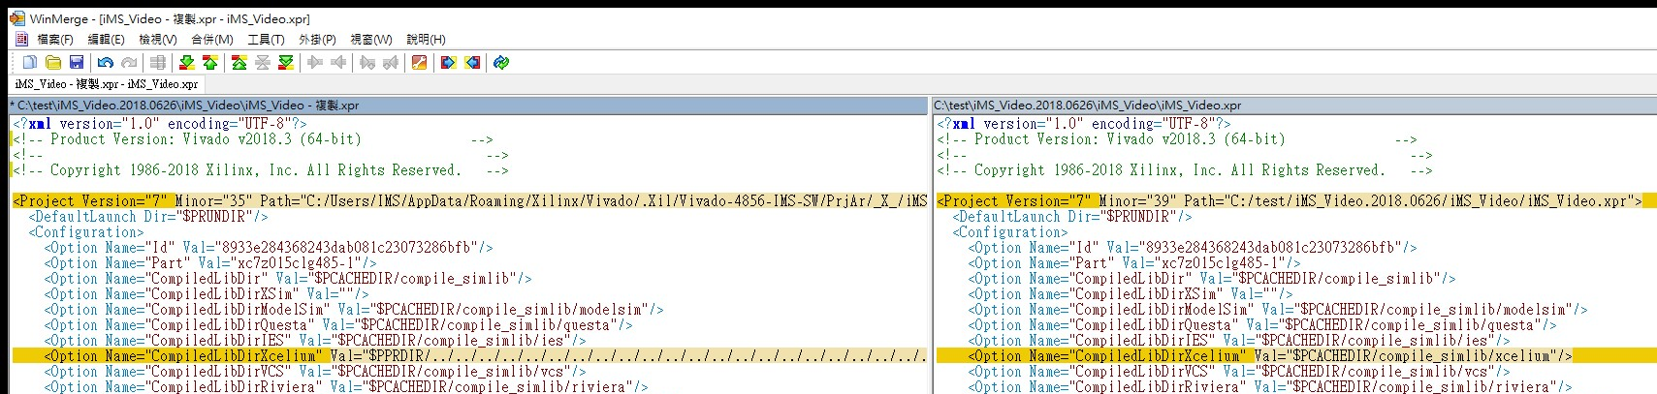
使用別人的專案
修改iMS_Video.xpr的兩個地方
程式碼所在的地方
編譯程式所在的地方

Slide 39
壓縮專案
Vivado
File/Archive Project
壓成.zip檔

Slide 40
GPIO
GPIO 共
Bank 0 0~31 32
Bank 1 32~53 22
Bank 2 54~85 32
Bank 3 86~117 32
面板按鍵是用 GPIOPS_BANK2

Slide 41
EEPROM
32個Page，每個Page為1KBytes

Slide 42
DMA
int dma_copy(u32 SrcAddr, u32 DstAddr, int length);
SrcAddr
DstAddr
Source
Destination

Slide 43
必要的修改
keyboard_host_app.c
usbh.c
OSD xv_mix_l2.c L566之 < 要改成 <=
UART xuartps_hw.c

Slide 44
xxxxxxx

Slide 45
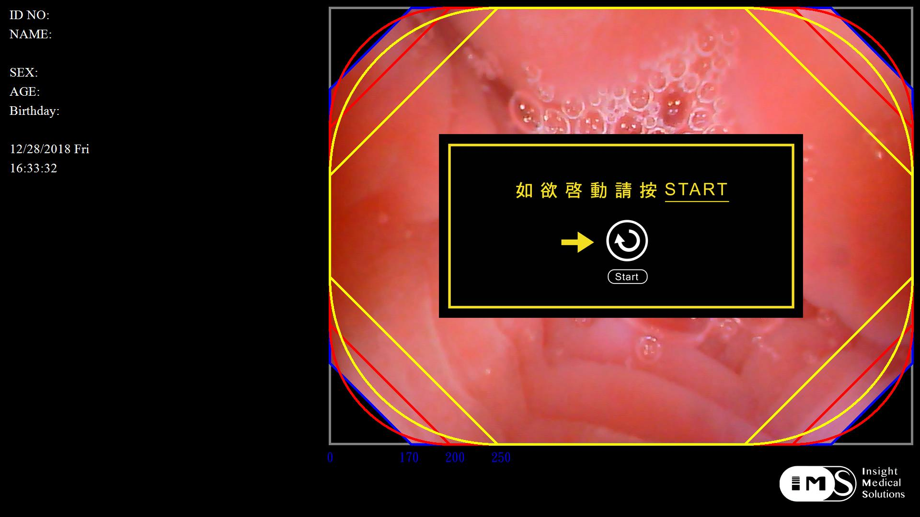
相機邊角遮黑

Slide 46
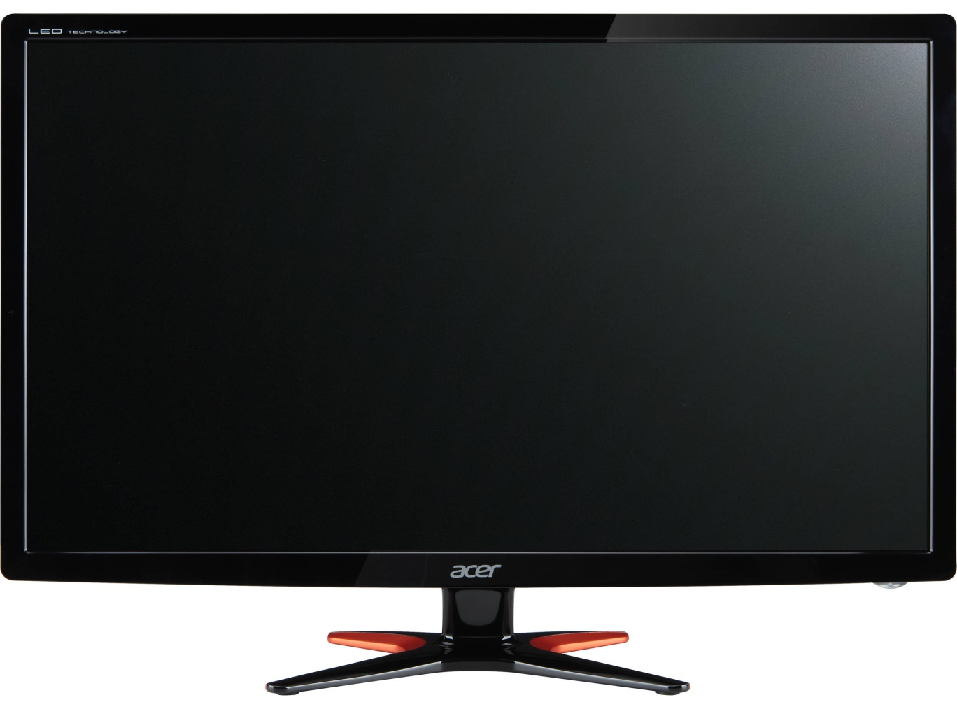
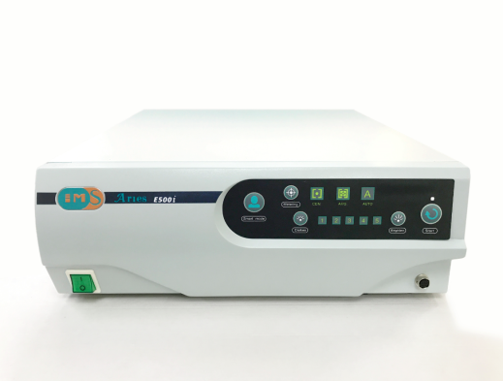
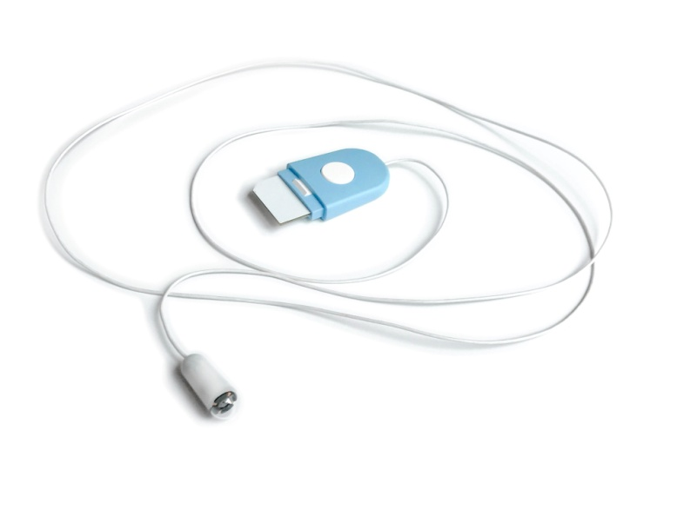

相機邊角遮黑設定
M$ Windows
Aries EGD System
（工廠程式）
讀
COM
3
寫
5
清除
0 : 無資料
1 : 10%
2 : 20%
3 : 30%
:
:
10 : 100%
8
寫在Page 0x08

